Slide 1
Effective poster presentations for research and design projects
Chad A. B. Wilson, Ph.D.
Director of Technical Communications Across the Curriculum
July 18, 2019

Slide 2
How do people read posters?
How should they be designed?
Notes:
Here is another variation. This one stresses the flow of the presentation by using arrows. It looks professional and it isn’t as boring as the bullet variation.

Slide 3
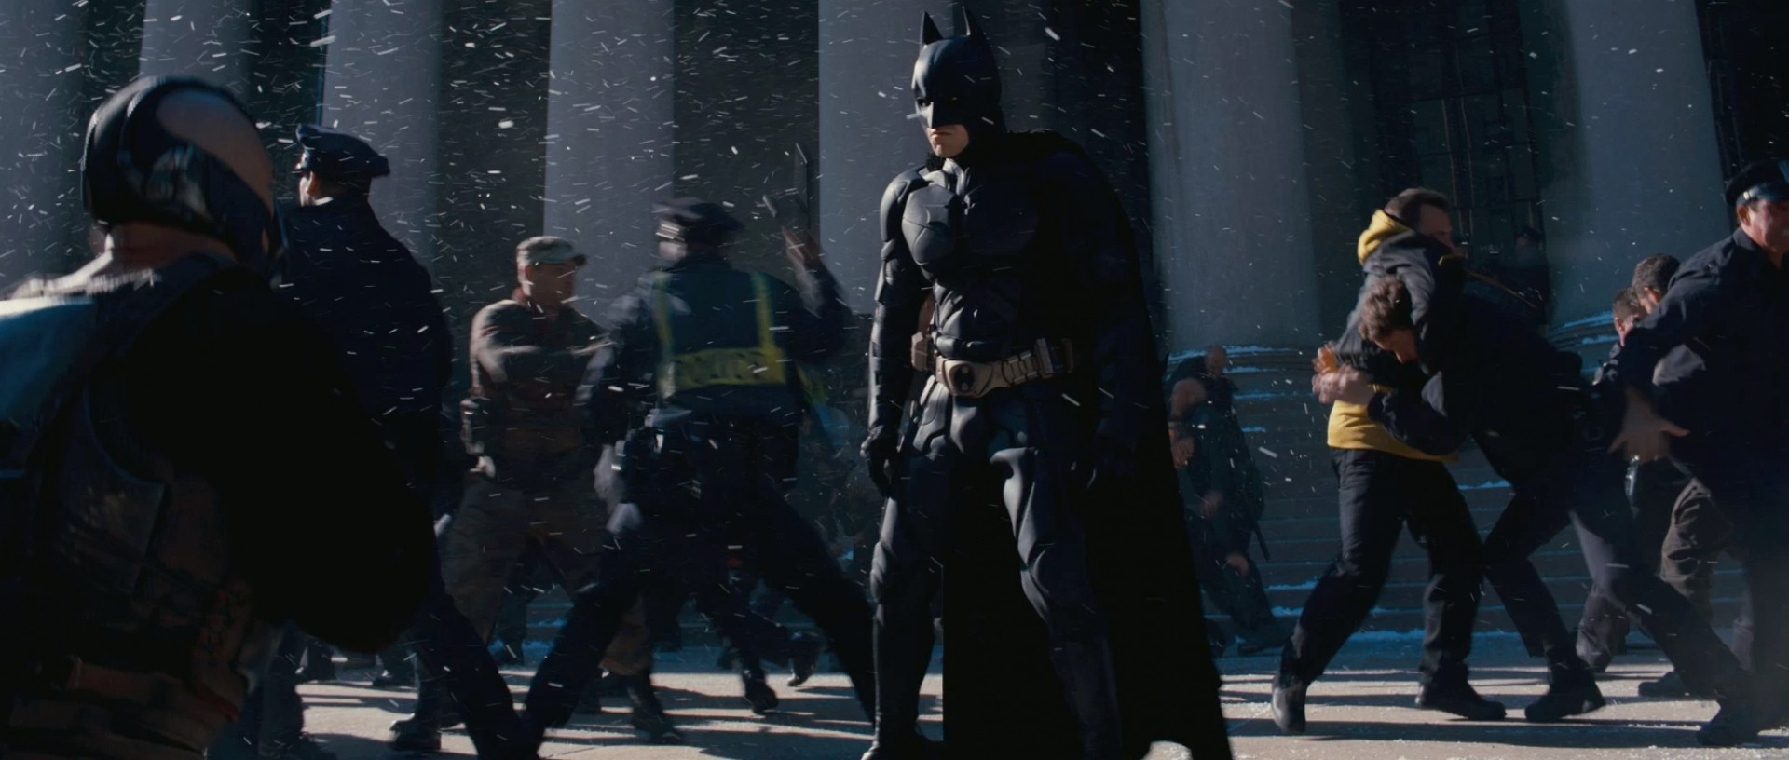
http://cinema.theiapolis.com/movie-2RUB/the-dark-knight-rises/gallery/batman-christian-bale-in-the-dark-knight-1073001~1.html

Slide 4
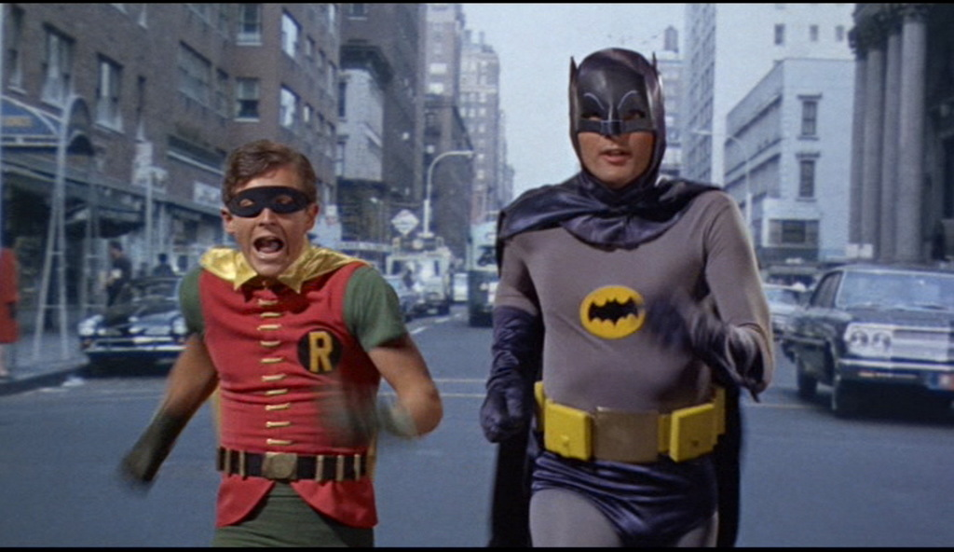
http://www.bleedingcool.com/2014/01/15/batman-1966/

Slide 5

https://www.reddit.com/r/FanTheories/comments/36jlej/the_joker_from_the_1960s_batman_series_and_movie/

Slide 6

http://3ashry.blogspot.com/2008_08_01_archive.html

Slide 7
Approach

Slide 8

From http://www.swarthmore.edu/NatSci/cpurrin1/posteradvice.htm
http://photos.asco.org/ASCO-Public/2009-ASCO-Annual-Meeting/ASCO-Slide-Show/i-tTkTcVD/A

Slide 9
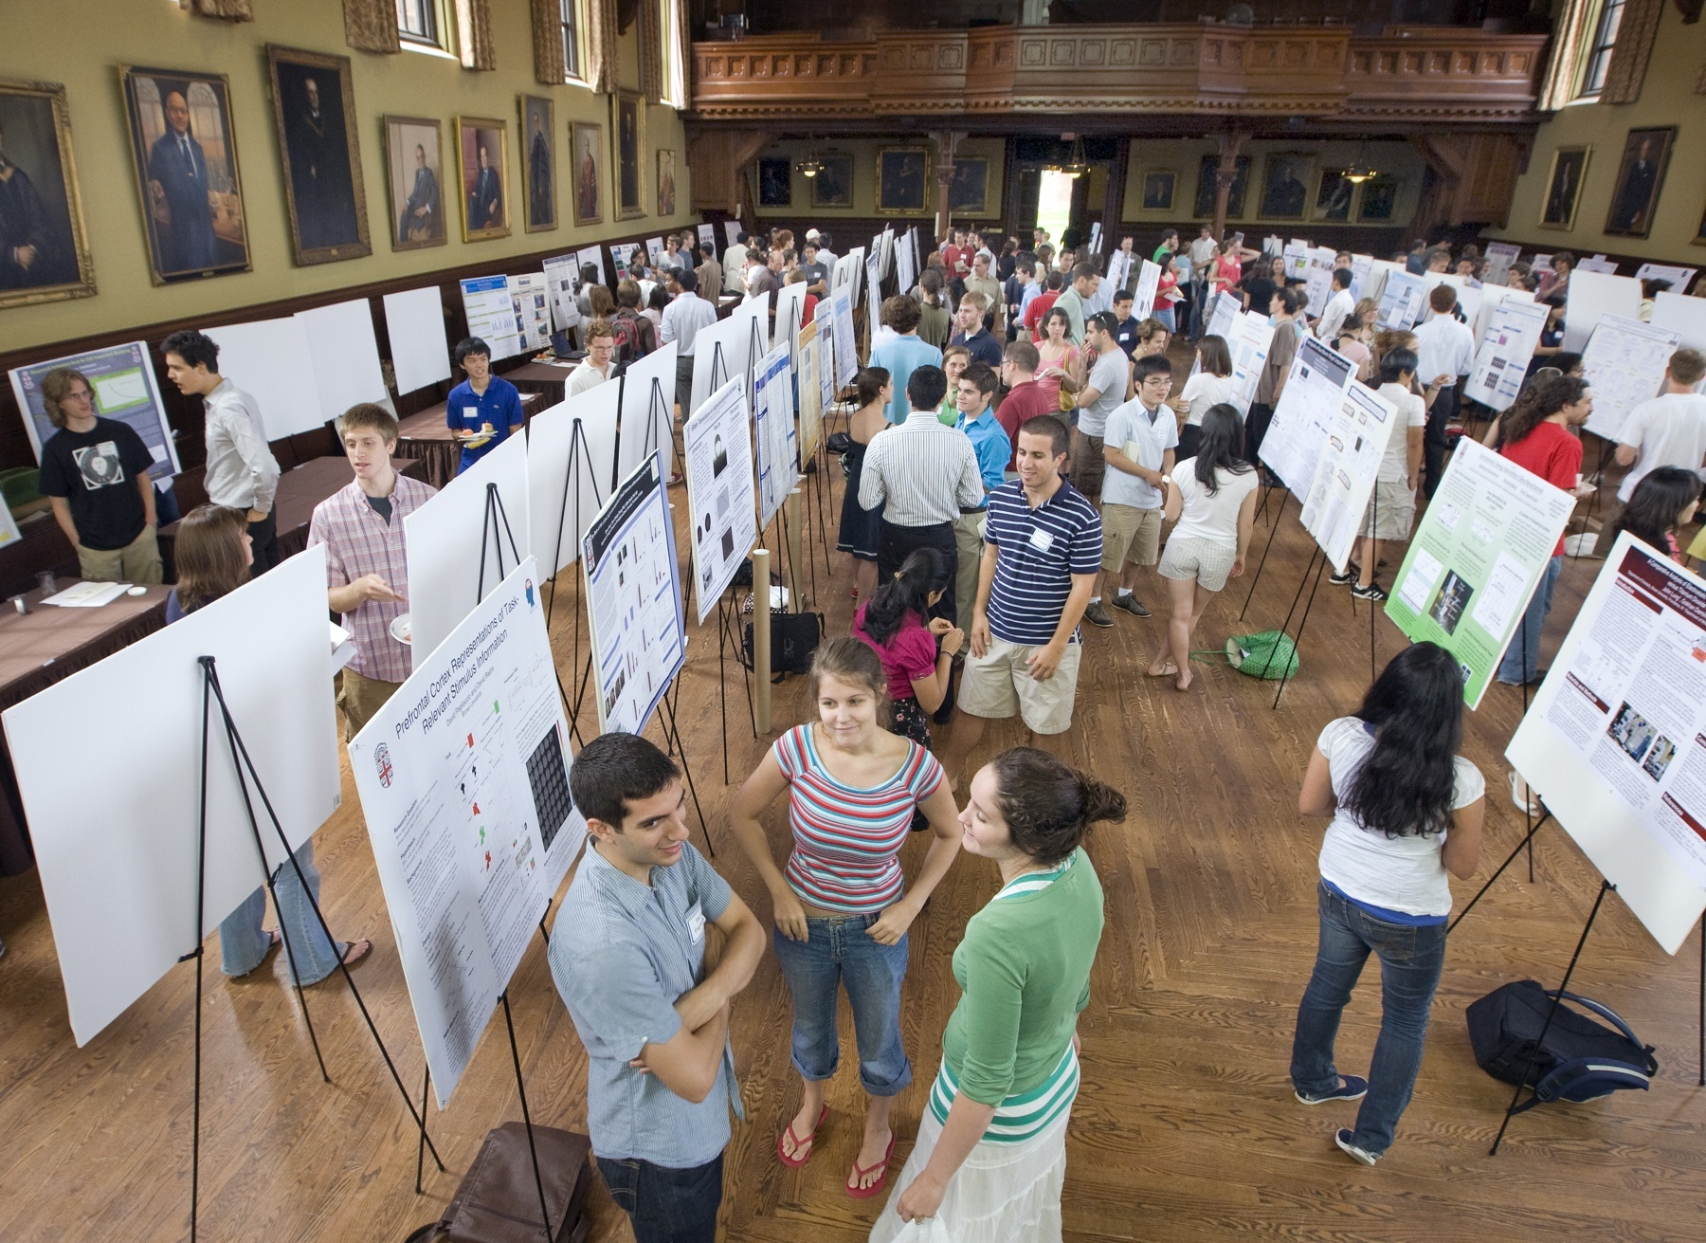
http://today.brown.edu/node/10663

Slide 10
Be excited!
Notes:
Slides need not say everything about the presentation, but they should provide a guide that helps the audience follow along and may serve as notes after the presentation.
This is really the way to balance it. The slides will contain all of the key information that you want the audience to take away from your talk, but the verbal part is the details, the elaboration on the slides themselves.

Slide 11
½
Information Grasped
Excitement
Level
=
Notes:
Like when you know class is about to end, everyone stops listening anyway

Slide 12
2
Excitement
Level
Information Grasped
=
200
Notes:
Like when you know class is about to end, everyone stops listening anyway

Slide 13
If you aren’t excited about the topic, why should anyone listen?
Amory Lovins TED Talk
Carolyn Porco TED talk

Slide 14

30 seconds

Slide 15
The AND AND AND Method

Slide 16
The ABT Method

Slide 17


Slide 18
What do you research?

Slide 19
“In my laboratory, we study physiology AND biochemistry, BUT in recent years we’ve realized the important questions are at the molecular level; THEREFORE, we are now investigating the following molecular questions….”

Slide 20
ECE 7373
Advance Topics in Computer Architecture
Multithreading – Simultaneous Multithreading
Presented by,
Team 2

Slide 21
Thread
Thread: single sequential flow of control within a program
Single-threaded program can handle one task at any time.
Multitasking allows single processor to run several concurrent threads.
Most modern operating systems support multitasking.

Slide 22
What is Multithreading?
Multithreading is similar to multi-processing.
A multi-processing Operating System can run several processes at the same time
  Each process has its own address/memory space
  The OS's scheduler decides when each process is executed
    Only one process is actually executing at any given time. However, the system appears to be running several programs simultaneously
Separate processes do not have access to each other's memory space
  Many OSes have a shared memory system so that processes can share memory space
In a multithreaded application, there are several points of execution within the same memory space.
  Each point of execution is called a thread
  Threads share access to memory

Slide 23
Why use Multithreading?
In a single threaded application, one thread of execution must do everything
  If an application has several tasks to perform, those tasks will be performed when the thread can get to them.
  A single task which requires a lot of processing can make the entire application appear to be "sluggish" or unresponsive.
In a multithreaded application, each task can be performed by a separate thread
  If one thread is executing a long process, it does not make the entire application wait for it to finish.
If a multithreaded application is being executed on a system that has multiple processors, the OS may execute separate threads simultaneously on separate processors.

Slide 24
What Kind of Applications Use Multithreading?
Any kind of application which has distinct tasks which can be performed independently
  Any application with a GUI.
    Threads dedicated to the GUI can delegate the processing of user requests to other threads.
    The GUI remains responsive to the user even when the user's requests are being processed
  Any application which requires asynchronous response
    Network based applications are ideally suited to multithreading.
      Data can arrive from the network at any time.
      In a single threaded system, data is queued until the thread can read the data
      In a multithreaded system, a thread can be dedicated to listening for data on the network port
      When data arrives, the thread reads it immediately and processes it or delegates its processing to another thread

Slide 25
How does it all work?
Each thread is given its own "context"
  A thread's context includes virtual registers and its own calling stack
The "scheduler" decides which thread executes at any given time
  The VM may use its own scheduler
  Since many OSes now directly support multithreading, the VM may use the system's scheduler for scheduling threads
The scheduler maintains a list of ready threads (the run queue) and a list of threads waiting for input (the wait queue)
Each thread has a priority. The scheduler typically schedules between the highest priority threads in the run queue
  Note: the programmer cannot make assumptions about how threads are going to be scheduled. Typically, threads will be executed differently on different platforms.

Slide 26
MULTITHREADING: Coarse - Grain Multithreading
Swith between threads only on costly stalls
This form of multithreading only hides long latency events.
Easy to implement but has large grains

Slide 27
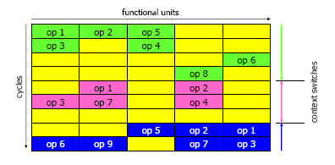
MULTITHREADING: Coarse-Grain

Slide 28
MULTITHREADING: Fine - Grain Multithreading
Context switch the threads on every clock cycle.
Occupancy of the execution core is now much higher
Hides both long and short latency events
Vertical waste are eliminated but horizontal waste is not. If a thread has little or no operations to execute issue slots will be wasted.

Slide 29
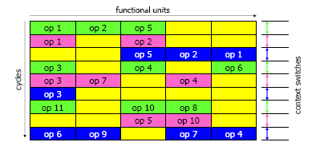
MULTITHREADING: Fine-Grain

Slide 30
Commercial Examples
Compaq Alpha 21464 (EV8)
  4T SMT
  Project killed June 2001
Intel Pentium IV (Xeon)
  2T SMT
  Availability in 2002 (already there before, but not enabled)
  10-30% gains expected
  Also called as Hyperthreading
SUN Ultra IV
  2-core CMP, 2T SMT
IBM POWER5
  Dual processor core
  8-way superscalar
  Simultaneous multithreaded (SMT) core: Up to 2 virtual processors per real processor
  24% area growth per core for SMT

Slide 31
Thank you

Slide 32
Order Proboscidea
Should probably be considered part of the Afrotheria. Closest living relatives are seacows and hyraxes (see next slide).
  Mammals, large size, with light brown to gray coloring
XX’s stay in natal group, cementing relationships w/mothers, grandmas, sisters, aunts, XX cousins….
Between ages 8-20yrs, XY’s think increasingly of sex & become such pests that XX’s run them out of herd. Thereafter they join bachelor society (next slide).
Vast variety of plants eaten (Kibale, Uganda: 227 of 255 known species) but most food is usually from few species.
Absorptive efficiency is low, and these animals meet minimal nutritional needs by eating large quantities of OK food or vast quantities of wretched food.
Notes:
[Leave slide up for 15-20 seconds.]
Anyone know what this slide is talking about?

Slide 33

From a presentation by Lee Hilyer, University of Houston
Notes:
Now let’s look at the next slide.
Which slide is more effective (and more efficient)?
This leads me to rule #2: SHOW the pictures.

Slide 34
Sensory inputs—sights and sounds—are processed differently in different parts of the brain. When inputs become a part of working memory, sights are processed in the visual channel, while sounds are processed in the auditory channel. This processing in working memory is necessary for encoding and retrieval to and from long-term memory. Different parts of the brain process the various inputs, which is why people usually have no problem watching a person while listening to him or her speak. The different parts of the brain can process two different inputs with very little confusion.
Written words cause problems when they are a major part of a presentation because they overload working memory’s visual and auditory channels that process the different inputs. Written text is processed first by the visual channel as it enters working memory through the sensory input of sight. We see text. Before written text can enter long-term memory, however, it must be additionally processed in the auditory channel. So written text is processed both in the visual channel as well as the auditory channel. Its longer processing means that it overloads the channels, especially the auditory channel. This longer processing is why some people have trouble reading subtitles while watching movies, but most people have trouble reading a book while listening to someone speak to them. Written text in a presentation means that the audience has trouble listening to the presenter. The channels trying to process the spoken words are also trying to process the written words.

Slide 35
Sensory Input
Sensory Input, both sights and sounds
First, goes into sensory memory
Then sensory input goes into working memory
  Through the visual channel
      Visual (pictures) are processed in the visual channel
  Through the auditory channel
      Spoken words are processed in the auditory channel
Then it moves into long-term memory
Words are first processed in the visual channel but then they get final processing in the auditory channel

Slide 36
Sensory Input
Sensory Input, both sights and sounds
First, goes into sensory memory
Then sensory input goes into working memory
  Through the visual channel
      Visual (pictures) are processed in the visual channel
  Through the auditory channel
      Spoken words are processed in the auditory channel
Then it moves into long-term memory
Words are first processed in the visual channel but then they get final processing in the auditory channel

Slide 37
Sensory Input
Sensory Input, both sights and sounds
First, goes into sensory memory
Then sensory input goes into working memory
  Through the visual channel
      Visual (pictures) are processed in the visual channel
  Through the auditory channel
      Spoken words are processed in the auditory channel
Then it moves into long-term memory
Words are first processed in the visual channel but then they get final processing in the auditory channel

Slide 38

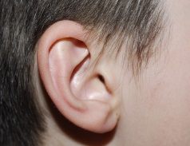
While text is first processed
in the visual channel…
Sensory Memory
Working Memory
Visual Channel
Long-Term Memory
(Storage)
Sensory Input
(Sights and Sounds)
Encoding
Retrieval
Auditory Channel
…final processing of text is completed in the auditory channel.
From a presentation by Lee Hilyer, University of Houston
Notes:
BECAUSE OF THE CONNECTIONS IN OUR BRAINS BETWEEN WRITTEN AND SPOKEN SPEECH, while text…

Slide 39
Simultaneous Multithreading: Model
Extend, replicate and redesign some units of superscalar to achive multithreading
Resources replicated
  State for hardware contexts (registers, PCs)
  Per thread mechanisms for Pipeline flushing and subroutine returns
  Per thread identiers for branch target buffer and translation lookaside buffer

Slide 40
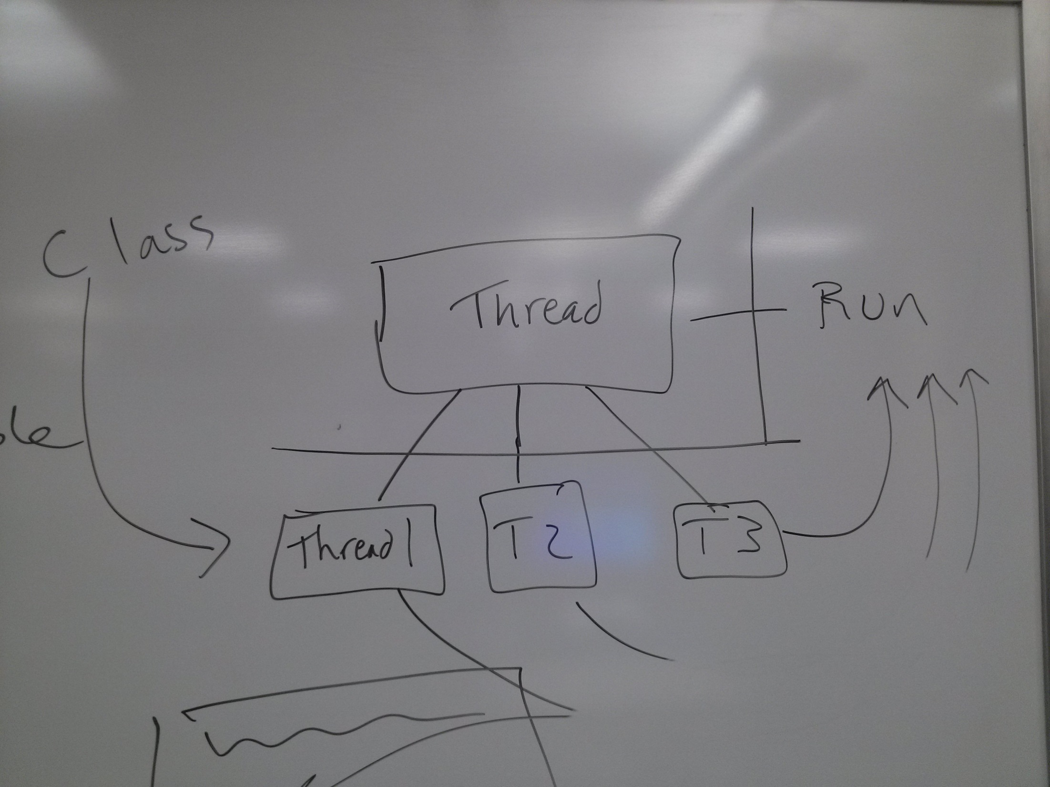
Notes:
Again, it’s about credibility. Remember what one of the key rules is: NEVER GO OVER THE AMOUNT OF TIME YOU HAVE. That’s because you don’t want to upset your audience and appear unprepared.

Slide 41
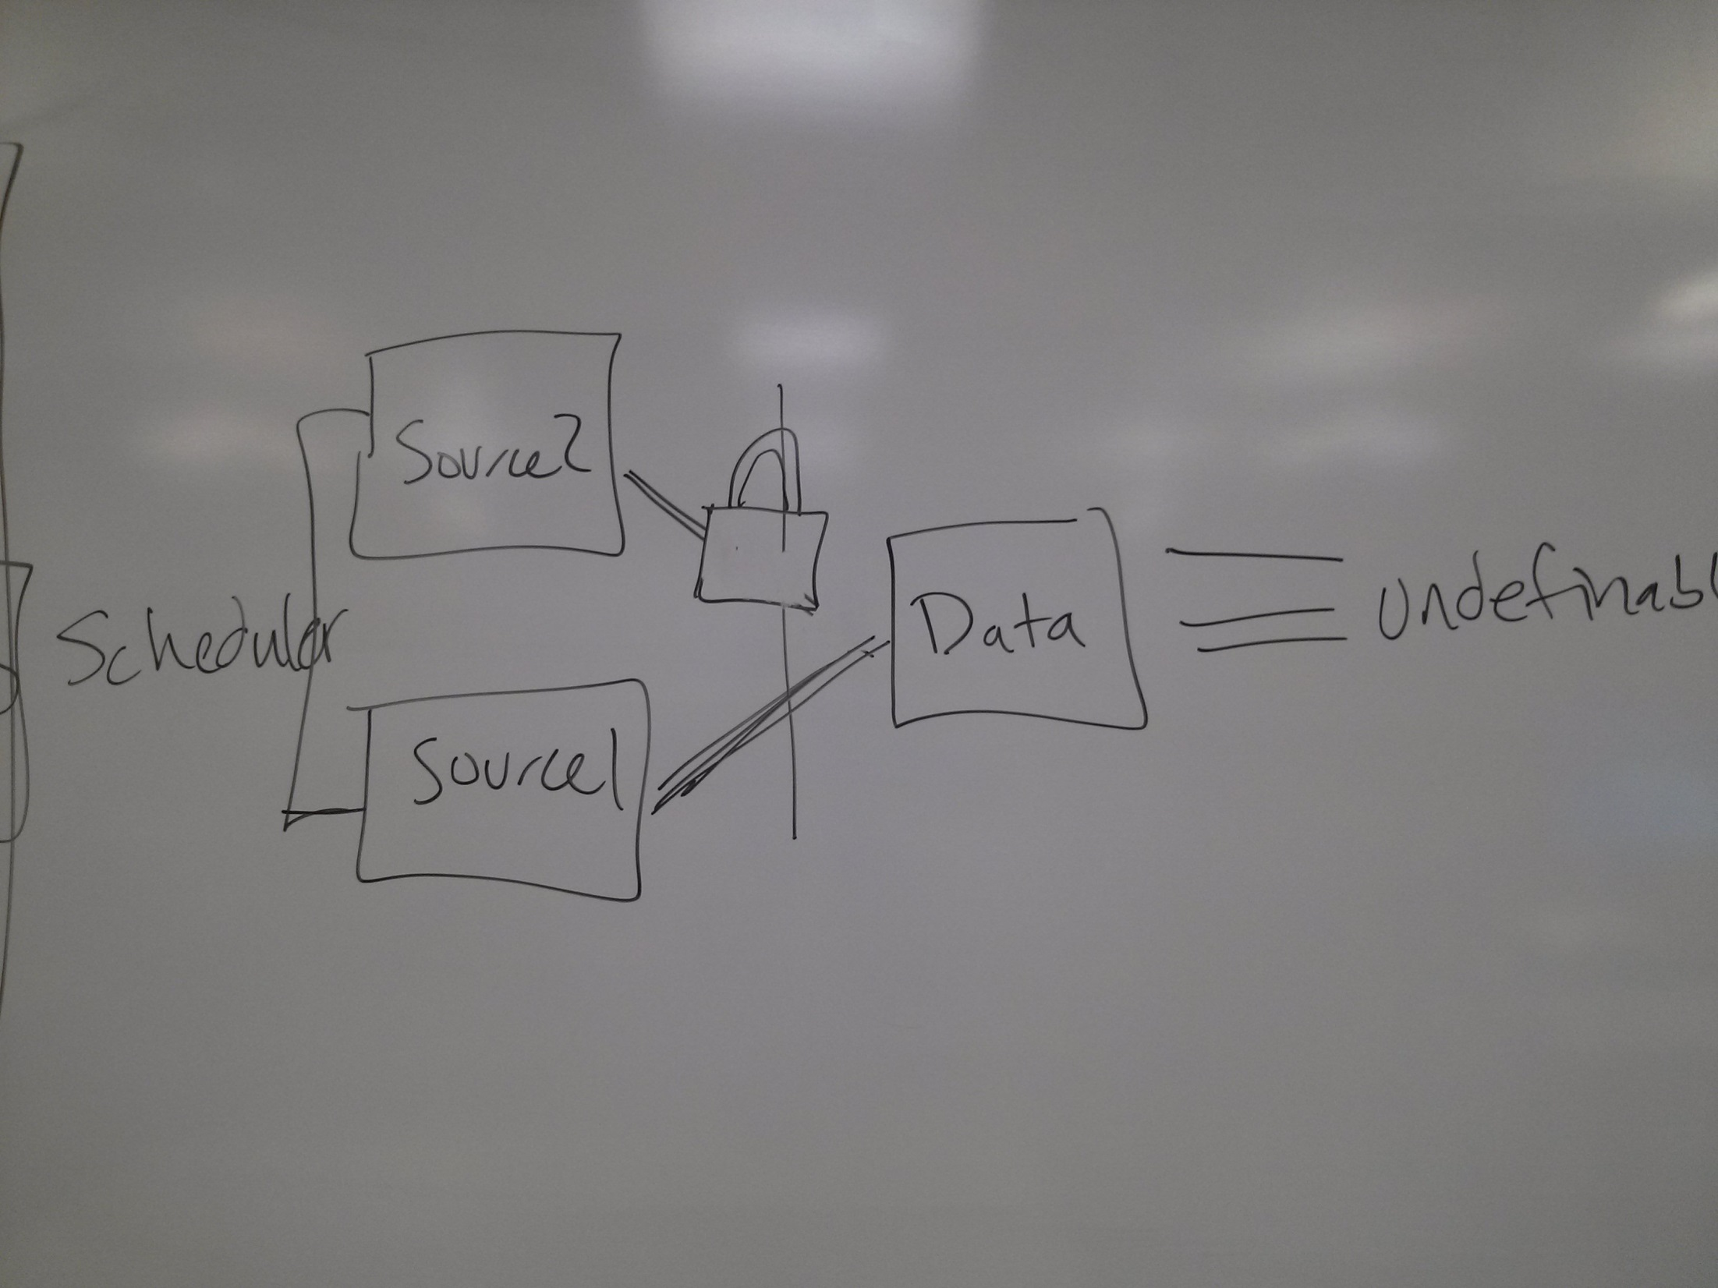
Notes:
Again, it’s about credibility. Remember what one of the key rules is: NEVER GO OVER THE AMOUNT OF TIME YOU HAVE. That’s because you don’t want to upset your audience and appear unprepared.

Slide 42
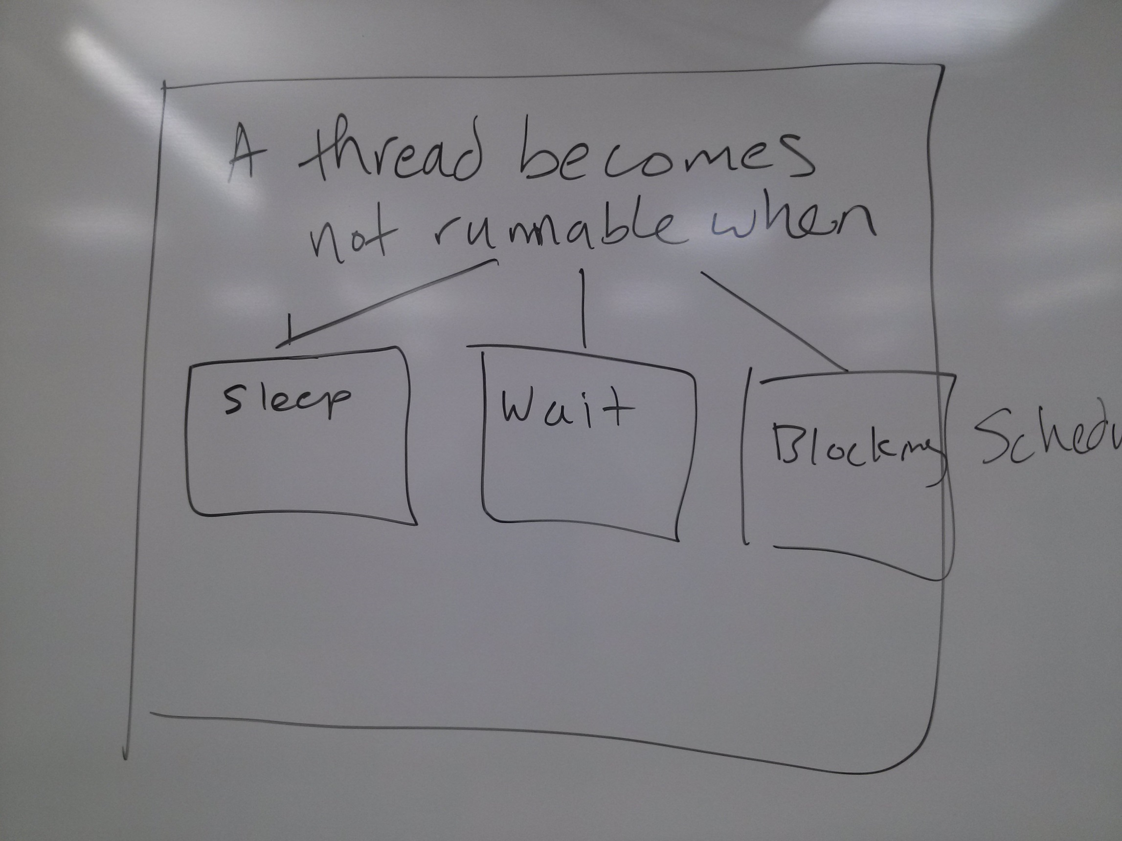
Practice your presentation at least once or twice.
Notes:
Again, it’s about credibility. Remember what one of the key rules is: NEVER GO OVER THE AMOUNT OF TIME YOU HAVE. That’s because you don’t want to upset your audience and appear unprepared.

Slide 43
Content

Slide 44
IMRaD

Slide 45
Introduction

Slide 46
Methodology

Slide 47
Results

Slide 48
Discussion

Slide 49
IMRaD

Slide 50
Aesthetics

Slide 51
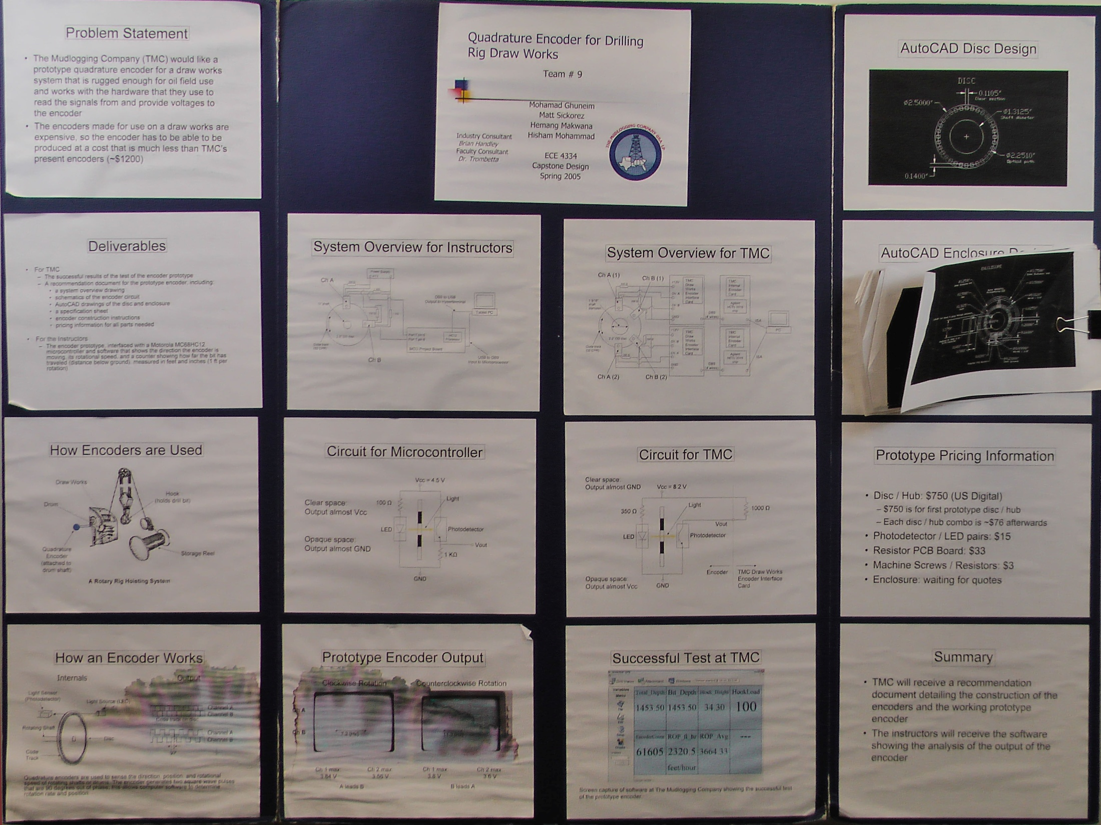

Slide 52


Slide 53


Slide 54


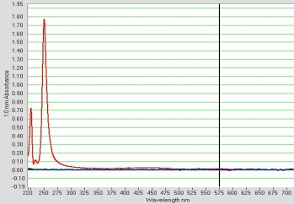
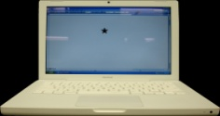



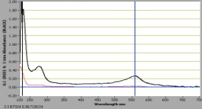
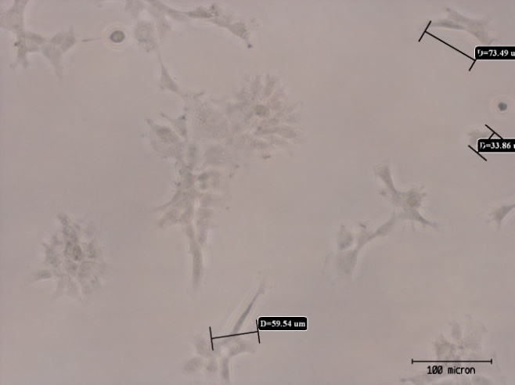

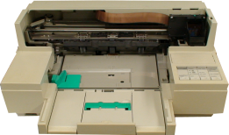
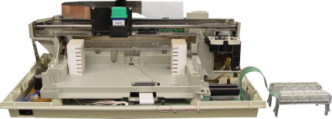
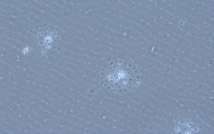
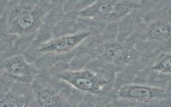
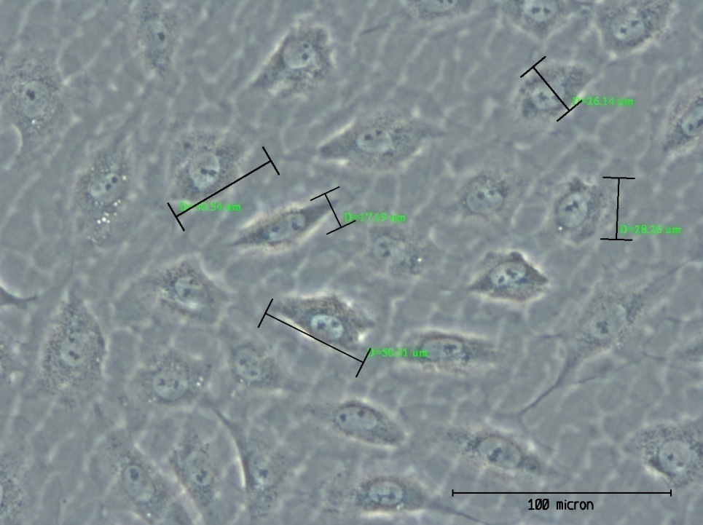
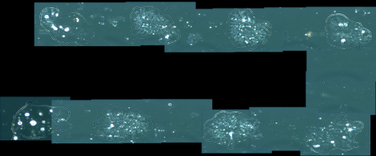
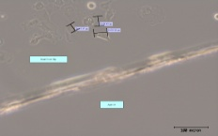
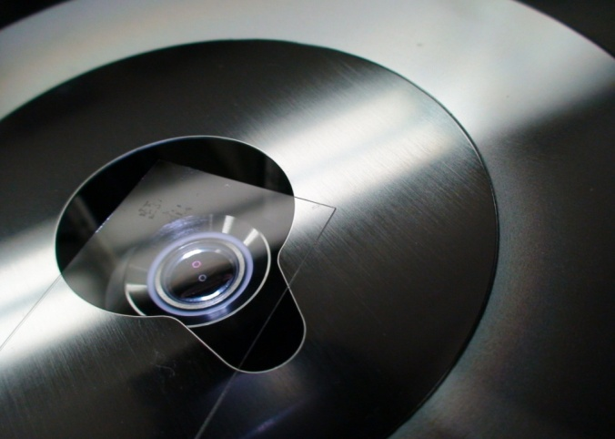
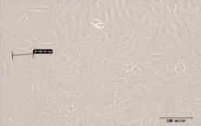
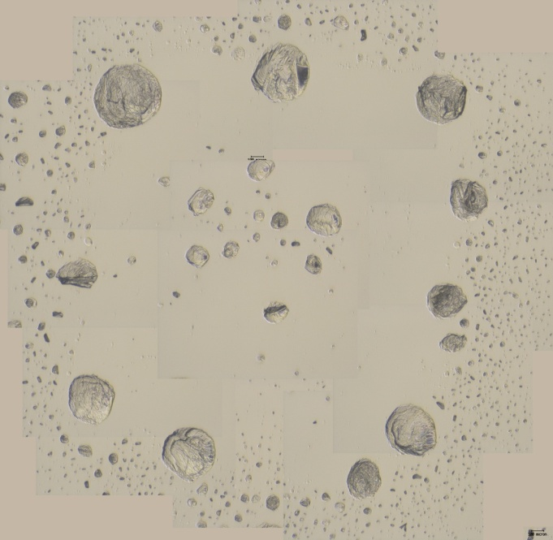
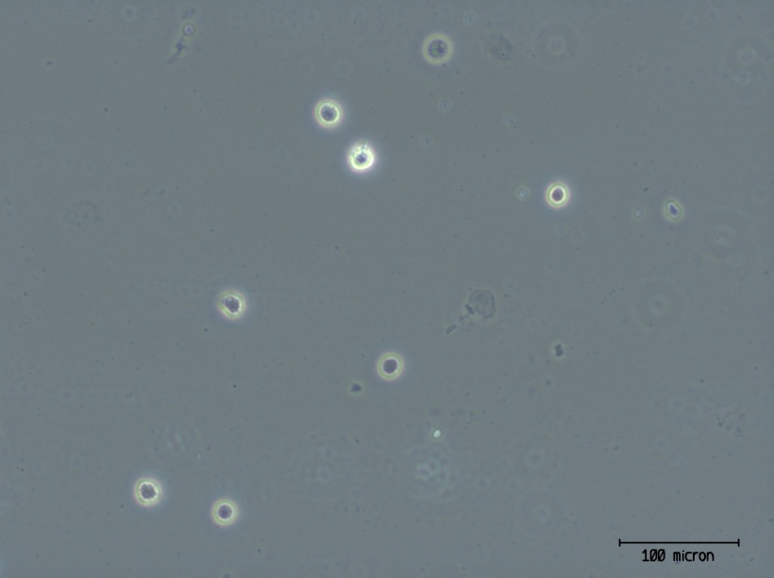
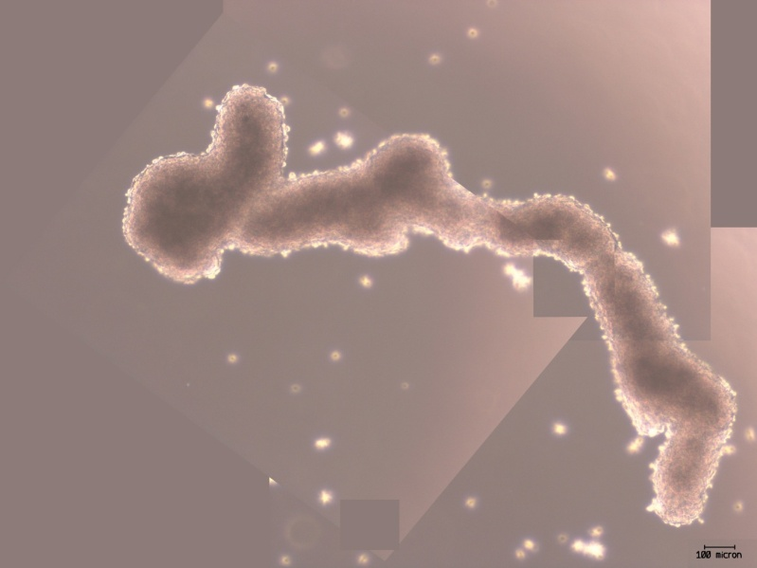
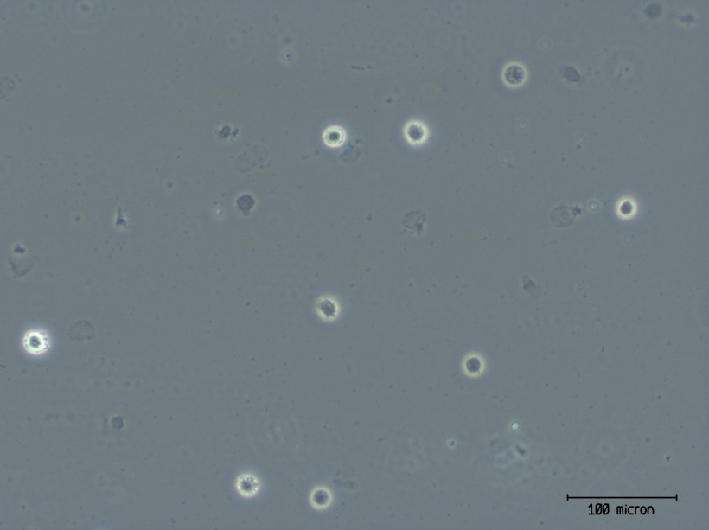
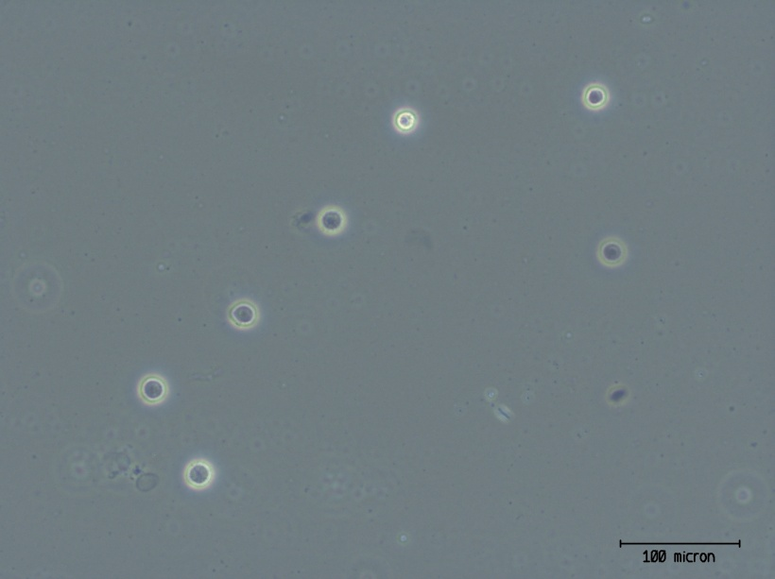
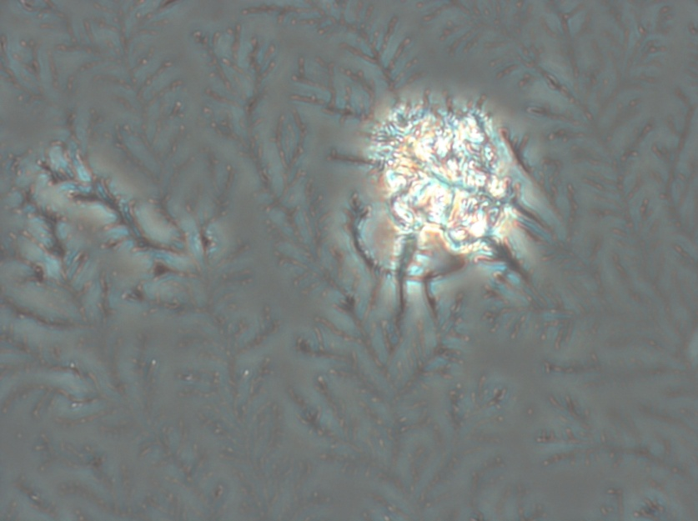
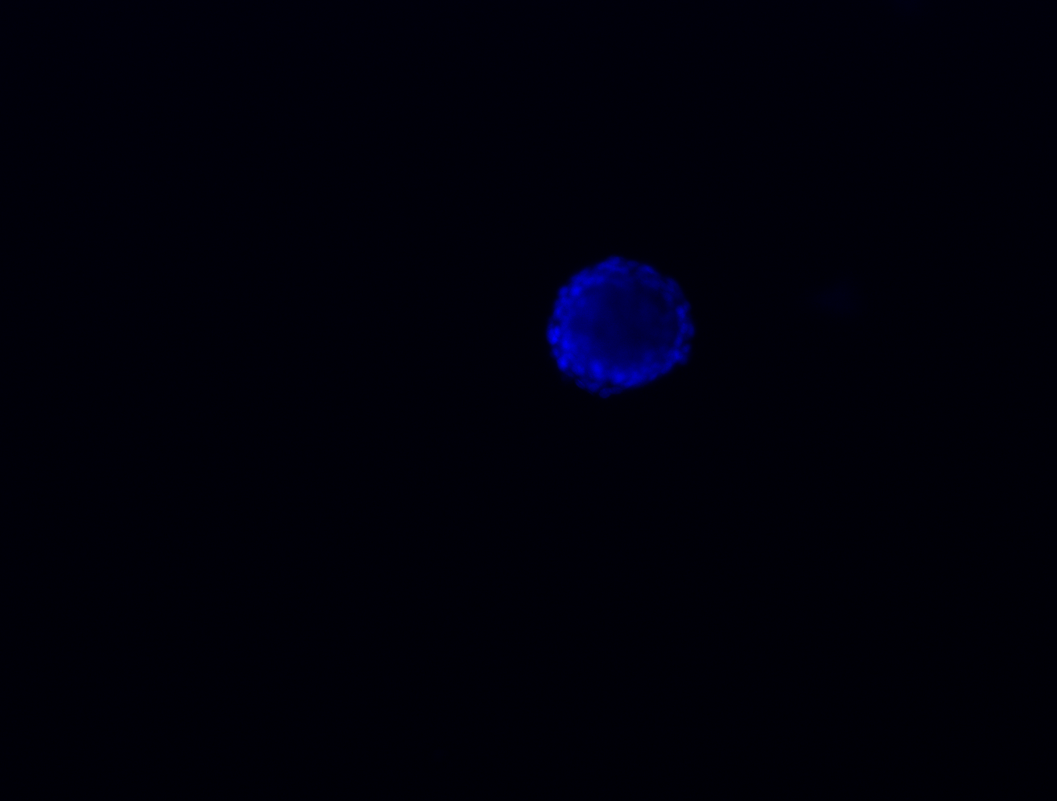
Cell Patterning with a Commercially Available Thermal Inkjet Printer
Biomedical Engineering Program¹ and Department of Electrical and Computer Engineering², University of Houston Cullen College of Engineering
INTRODUCTION: THE PROBLEM
SYSTEM DESIGN AND ANALYSIS
98,000+ organ failure patients are now on a waitlist to receive a transplant that may come years later [1].
To combat this problem, tissue engineers are researching ways to build whole, transplantable organs from individual cells.
One major problem faced in this research is the difficulty in placing specific cells in precise locations.
1
Syringe
IS THE CARTRIDGE REALLY CLEAN?
A
=
Ink (A) does not share the same light absorbance profile as printed bio-ink (B) and indicates that the cartridge is clean of ink.
Bio-ink in
print reservoir
Rat2 cells had near 100% viability when cultured with ink diluted in media.
Transfer of bio-ink
0.840 mm hole
B
Use graphics applications (e.g. Word) to design desired pattern.
Clean cartridge with 91% isopropanol and deionized water.
Puncture hole into print reservoir for direct loading of bio-ink.
Formulate bio-ink and transfer to cartridge.
DELIVERABLE: THE SOLUTION
Solutions to this problem have been attempted by researchers. Our goal is to reproduce one such solution: the modified thermal inkjet printer.
Specifically, we modified a HP 520 DeskJet printer to pattern living Rat2 fibroblasts.
2
Install cartridge onto printer.
Place receiving bio-paper on bio-paper tray.
Press print and pull mechanical switch to bypass paper feed.
Printer Modifications
BIOMATERIALS
Bio-paper
Several materials were used as bio-paper to test the adhesion of manually seeded Rat2 fibroblasts. This testing is vital as it will determine the location of the patterned cells.
Wheels removed
External casing removed
Ink removed and
cartridge cleaned
Cell debris
Agarose
Agarose
Cells adhered?
20X magnification
1 days post seed
Poisson’s distribution indicating the probability of the amount of cells appearing in a printed period (Times New Roman, 8 pt. font – seen in chart title at 500X zoom) as a function of cell concentration in a drop (140 pL volume).
Bio-paper tray assembled
Yes
✓
No
Mechanical switch installed
70 µm
Petri dish plastic
Cells adhered?
40X magnification
5 days post seed
3
View pattern under microscope.
Add nutrient media after 30 minutes to sustain cells and put into incubator.
DISCUSSION AND RECOMMENDATIONS
23 µm
✓
Yes
No
Results reveal that a major factor affecting cell viability is moisture and osmolarity. Without printing in the same spot for many times, the bio-ink will evaporate and the resulting salty environment will kill cells.
  - To prevent this, some parameters, such as temperature, number of passes, and the bio-paper, may be manipulated to slow down the rate of evaporation.
We have tried an alternative to directly printing cells: manually depositing cells onto a printed surface pattern that can either attract (figure C in part 3) or repel cells (figure B in part 3), allowing the cells to redistribute themselves according to surface properties of the printed material. However, all patterns were disrupted once media was added.
  Further testing of surface tension and charge needed.
Current Prints
Glass cover slip
Cells adhered?
10X magnification
2 days post seed
Glass Cover Slip
✓
Yes
No
A
Agarose
Rat tail collagen I
Cells adhered?
10X magnification
5 hours post seed
B
D
68.49 µm
✓
Yes
No
D: Printed Rat2 cells suspended in 0.1X PBS. 51.1% viability determined with Trypan blue staining in 6 random fields.
Bio-ink
C
DEAD
ALIVE
0.1 x PBS
Able to sustain cell viability for up to 30 minutes. However, after printing, it will quickly evaporate (~30 seconds for 5 overlapping prints) and leave the cells in a lethally salty environment (see image on right).
REFERENCES
1. "United Network for Organ Sharing." UNOS. 2008. United Network for Organ Sharing. 17 Apr. 2008 <http://ww.unos.org>.
A: Printed 2x4 dot array pattern with Rat2 cells suspended in 0.1X PBS. Evaporation 30 seconds post print.
B: Printed ring pattern (see upper right of picture) of agarose onto glass cover slip, seen at 4X. Pattern disappears after cell and media deposition.
C: Rat2 cells manually seeded and adhered onto printed collagen I (some collagen I lifted after addition of media. Fluorescent microscopy (bottom left of picture) verifies cell presence.
ACKNOWLEDGEMENTS
Precipitated salt formation enveloped cell
Project supported by The University of Houston Cullen College of Engineering. Many thanks to D. Martinez, Ph.D. and L. Gutierrez, Ph.D. for their guidance and support and to M. Franchek, Ph.D. for use of the Biomedical Engineering Research Core Laboratory (BMERCL).

Slide 55


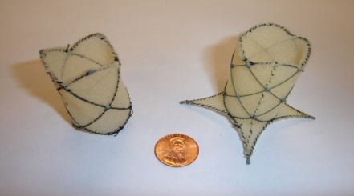
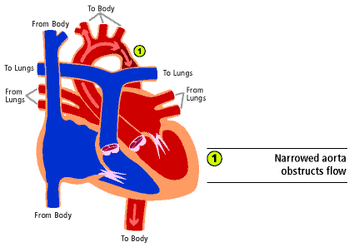
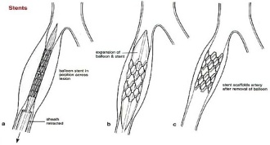
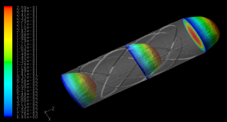
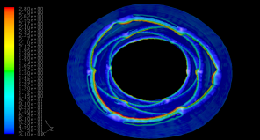
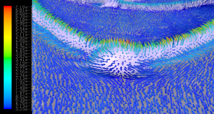
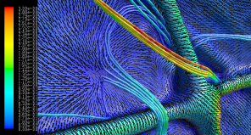
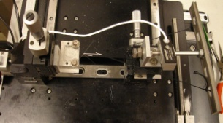
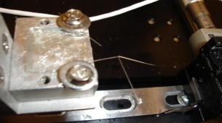
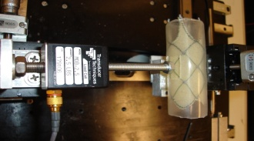
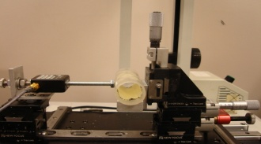
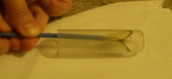
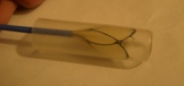
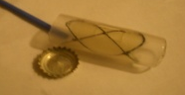

Novel Stent for the Correction of Aortic Coarctation
Department of Biomedical Engineering, University of Houston
Background
Background
Congenital Heart Disease (CHD) affects 7-8 out of 1000 people. Aortic Coarctation (AoC) is the third most common CHD accounting for about 10% of all cases. Coarctation of the aorta is a discrete or long narrowing of the distal segment of the aortic arch as can be seen in figure 1 [1].
Figure 11 Radial stiffness recorded during loading (top curve) and unloading (bottom curve) of the stent.
Figure 12 Radial stiffness recorded during loading (top curve) and unloading (bottom curve) of the stent.
Modeling
Figure 6 Stent Prototypes #1 with three circumferential cells (left), and #2 with four circumferential cells and anchors on one end (right).
Modeling
Joint Testing
A computational fluid dynamic simulation (Re=800) was conducted to asses the advert effects of the deployed uncovered stent on blood flow. To conduct the simulation, a virtual geometry of the stent was generated using computed tomography and image reconstruction software. The computational mesh was generated using Gambit and the numerical simulation was performed using Fluent.
Blood was modeled as a single phase incompressible fluid with a constant viscosity of 4x10⁻³ [N s/m²] and a constant density of 1060 [kg/m³]. The arterial wall was modeled using a rigid wall assumption.
Figure 1 Aortic Coarctation shown in relation to the heart. (courtesy of the University of Washington)
Figure 2 Balloon expandable stent used to expand a narrowing. (courtesy of the University of Southern California)
Joint Testing
Methods used to correct AoC include both surgical and less invasive, percutaneous (through the vascular system) methods. Surgery involves removal of the narrowed site and subsequent implantation of a graft. Balloon angioplasty is a percutaneous precedure which invovles the introduction of a balloon catheter to the narrowing and subsequent expansion of the narrowing. Due to a high incidence of restenosis observed after balloon angioplasty, stents have been used to add permanent support to the vessel [2]. A stent is a metallic scaffold which can be inserted percutaneously and expandend at the desired location. There are two types of stents: those which are expanded using a balloon shown in figure 2 (plastic deformation) and those which expand by themselves (elastic deformation) [3]. Many currently used stents, especially those used to correct AoC, employ joints fabricated by welding. Joints experience the largest strains of any part of the stent and combined with the compromised structural integrity of welding make them the leading site of fracture [4].
Corrosion
Corrosion testing was conducted on our epoxy joint design in conjunction with testing on stainless steel and nitinol welded joints similar to those used in industry. The sample joints were placed in beakers and soaked in an isotonic saline solution that was 6% sodium by mass. The joints were soaked for 20 days. Resistance measurements were taken on the experimental samples three times a week. Photographs were taken of the samples in solution twice a week. Controls kept in air had resistance measurements taken for contrast. Controls in saline were not removed for resistance measurements, but were photographed.
Break Point
After the end of the 20 day period, a break point test was conducted on all the joints. A force transducer [Transducer Techniques, Temecula, CA] was used to measure the force required to break each joint. The tabulated data is shown in the table below.
Table 2. Corrosion and Break Point Test Results
Figure 13 Contours of velocity magnitude [m/s] showing the fully developed flow profile.
Objective
 | Photographed | Ω | Corrosion | Break Force
Experimental Stainless | X | X | Heavy | 40.4 N
Stainless Saline Control | X |  | Light | 7.31 N
Stainless Air Control |  | X | None | 52.1 N
Experimental Nitinol | X | X | Moderate | 7.29 N
Nitinol Saline Control | X |  | Moderate | 5.98 N
Nitinol Air Control |  | X | None | 8.76 N
Experimental Epoxy | X | X | Light | 39.2 N
Epoxy Saline Control | X |  | Light | 42.1 N
Epoxy Air Control |  | X | None | 40.2 N
Figure 13 Contours of velocity magnitude [m/s] showing the fully developed flow profile.
Figure 14 Effects of joint thickness and stent luminal protrusion on wall shear stress [Pa]
Objective
To design, construct, and test a novel aortic stent for the correction of Aortic Coarctation with the following design specifications:
Self-expandability
Autonomous (manufactured separately) joints
13-14 Fr diameter when fully compressed
25 mm diameter when deployed
3 - 7 N radial stiffness
Figure 15 Near-wall velocity magnitude vectors showing a zone of stagnation resulting from flow impingent on the stent joint.
Figure 16 Pathlines, wall shear stress contours [Pa], and projected velocity vectors showing zones of reverse flow near a stent joint.
The introduction of the stent does not alter the overall profile of blood flow as seen in figure 13.
Wall shear stress (WSS) increases with increased protrusion into the arterial lumen as seen in figure 14. Endothelial cells’ healthy WSS in arteries ranges from 1 to 7 Pascals [5]. The joints and struts should experience endothelialization.
Flow impingement at the proximal joint causes a zone of stagnation as seen in Figure 15. Stagnation zones correlate with thrombus formation and should, thus, be avoided by optimizing the shape of the proximal joints.
Reverse flow, as shown in figure 16, correlates with plaque formation and stenosis [5]. The joint and strut thickness should be reduced to avoid reverse flow.
Prototype Devices
Prototype Devices
Two prototype stents were constructed according to the additional design specifications shown in table 1. The two prototypes, shown in figure 6, were validated using the delivery model shown in figures 3-5.
Table 1. Prototype design specifications
Figure 7 Tensiometer assembly for joint break test.
Figure 8 Stainless steel broken joint after point break test.
Conclusion
Radial Stiffness
Conclusion
 | Prototype #1 | Prototype #2
# of circumferential cells | 3 | 4
Fully compressed diameter (Fr) | 13 | 14
Deployed diameter (mm) | 25 | 25
Axial length (mm) | 50 | 48
Core material | Nitinol | Nitinol
Exterior material | Stainless Steel | Stainless Steel
Joint material | Epoxy | Epoxy
Cover material | Polyurethane foam | Polyurethane foam
Anchors | No | Yes
Radial Stiffness
This study yielded favorable results for the design, but also elucidated specific changes which must be made. Corrosion and break point tests demonstrated that the epoxy joints are comparably strong to welded joints and are less prone to corrosion. The radial stiffness of both prototypes failed to meet the required benchmark, but a ~45% increase in radial stiffness was observed with the addition of one circumferential cell in prototype #2. The addition of more cells should raise the radial stiffness to the desired value. Fluid dynamic modeling demonstrated acceptable affects of the uncovered stent on blood flow, but also suggests that a decreased joint thickness and the added cover could improve results. Given appropriate resources for improved joint construction and more extensive corrosion and break point testing future prototypes with more circumferential cells could advance to the animal trials phase of development.
Figure 9 Top view of radial stiffness measuring assembly.
Figure 10 Side view of radial stiffness measuring assembly.
Acknowledgements
Radial stiffness measurements were taken using the assembly seen in figures 9-10. A prototype was placed into a 25 mm diameter, aortic compliance, silicone tube with a 10 x 10 mm² window cut on the side. After positioning a joint at the center of the window, a rod attached to a force transducer was placed directly on the joint. The silicone tube was then pushed towards the rod in 1 mm increments for 13 mm and then was unloaded with the same increments. The results of the test can be see in figures 11-12.
Figure 3 Deployment (~30%): stent being pushed out of a 13F sheath into a 25 mm silicone tube.
Figure 4 Deployment (~60%): stent being pushed out of a 13F sheath into a 25 mm silicone tube.
Figure 5 Deployment (100%): fully deployed stent.
The team would like to thank Custom Medical Devices (Athens, Greece), Dynatek Dalta (Galena, Missouri), and Fort Wayne Metals (Fort Wayne, Indiana) for their generous support of this project. We also extend thanks to Dr. Metcalf, M. Ionescu, Dr. Sun, and Dr White for their contributions. Finally we would like to thank our advisor Dr. Capitono for his guidance.

Slide 56



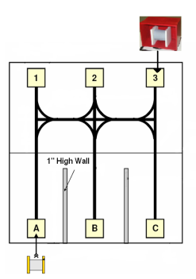
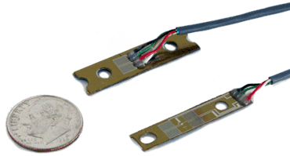
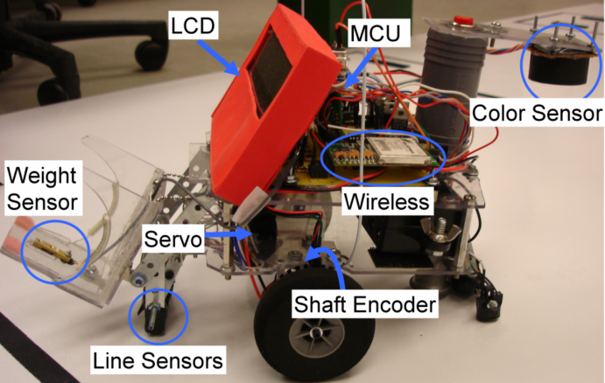

IEEE Robotics Competition: Team 1
Background
- Annual IEEE robotics competition for undergraduate students
- Theme: Safely move hazardous materials without human interaction
- Casks represent empty, partially full and full casks of hazardous materials.
- Casks placed at A, B and C
- Casks delivered to colored bins
located at 1, 2 and 3 on the track
- Casks and bins will be placed by judges in random order
- A sequence will be provided such as heavy to red, light to yellow, medium to green at the beginning of the run
- Dimensions of the robot must be less than 16”x16”x32”
- Weight of the robot must be less than 50 lbs.
Overview Diagram
How does the robot follow the line?
        - Uses a modified proportional algorithm
        - Depending on the error it adjusts the speed of each motor to correct back to the line
        - Digitizes output signal from line sensors using A/D converter
- Uses software thresholds to differentiate between black and white
- Can follow the left edge, right edge or center of the line
- Speed: maximum of 2.2 ft/s
Can accurately follow straight lines and 8 inch curves
Hyper-terminal
Shaft
Encoders
Wireless
Module
Line
Sensors
An array of six sensors as they
move over a black line from right to left
8X8 ft track
8’’ radius
Weight
Sensor
MCU
LCD
Color
Sensor
H-Bridge
Servo
How are the casks weighed?
Weight sensor/Thin beam force sensor:
measures deformation (strain) caused
by the cask
As it is deformed the electrical
resistance changes and a wheatstone
bridge is used to measure this change
The change is amplified and then
correlated to weight in grams
- Weights of casks: 63g, 126g, 189g
The weight sensor is located on the
lifting mechanism so the cask is
weighed as it is picked up
Motors
Weight sensor
Goal
To build an autonomous robot that can pick up, weigh, display the weight and correctly drop off all three casks to color coded destinations within three minutes.
1.0
Heavy
Medium
Light
0.75
0.5
How does the robot travel without following the lines?
-Uses shaft encoders to
determine distance and
make precise turns
-Shaft encoder disks are
mounted on the motor shafts
in a position so that they will
rotate through and be detected
by the shaft encoder sensors
-As the wheels turn the processor
keeps count of the segments that have rotated
through the sensor and correlates that to a distance the robot has
traveled
-Shaft Encoder Disks: 72 segments with a resolution of 0.2 inches
-Turns: ± 2 degrees of error
0.25
Lifting
Mechanism
A distribution of the weights of each of the three cans: 63g - light, 126g - medium, 189g - heavy.
How are the bin colors detected?
        -The color sensor is located on the back of the robot so it detects color on the top surface of the bin
        - Color sensor: uses red, blue and green LED’s that sequentially turn on
        - Light bounces back to the sensor and a signal is recorded for each LED
        - Frequency is calculated for each signal
        - Frequency ratios: Red/Blue and Red/Green are calculated and used to categorize the color of the box as seen in the graph to the left
- Color calibration function: made to calibrate the color sensor to make it accurate for all lighting conditions and distances, within 3 cm from the top of the bin
- Color calibration is used every time the robot is moved to a different
environment
Shaft encoder disk and sensor
σ = 2
The error, deviation from a straight line,
in degrees of the shaft encoders. Twenty
different measurements were taken after
traveling 63 inches.
The three regions representing the colors
of the bins: yellow, red and green. The frequency
ratios were used to set the thresholds (dotted lines)
for the three regions. This graph shows ten test
values for each color.
Results
The robot correctly delivered all three casks 110 times in less than a minute. The average time of a run was 51 seconds. The longest run took 59 seconds and the shortest run took 41 seconds.

Slide 57
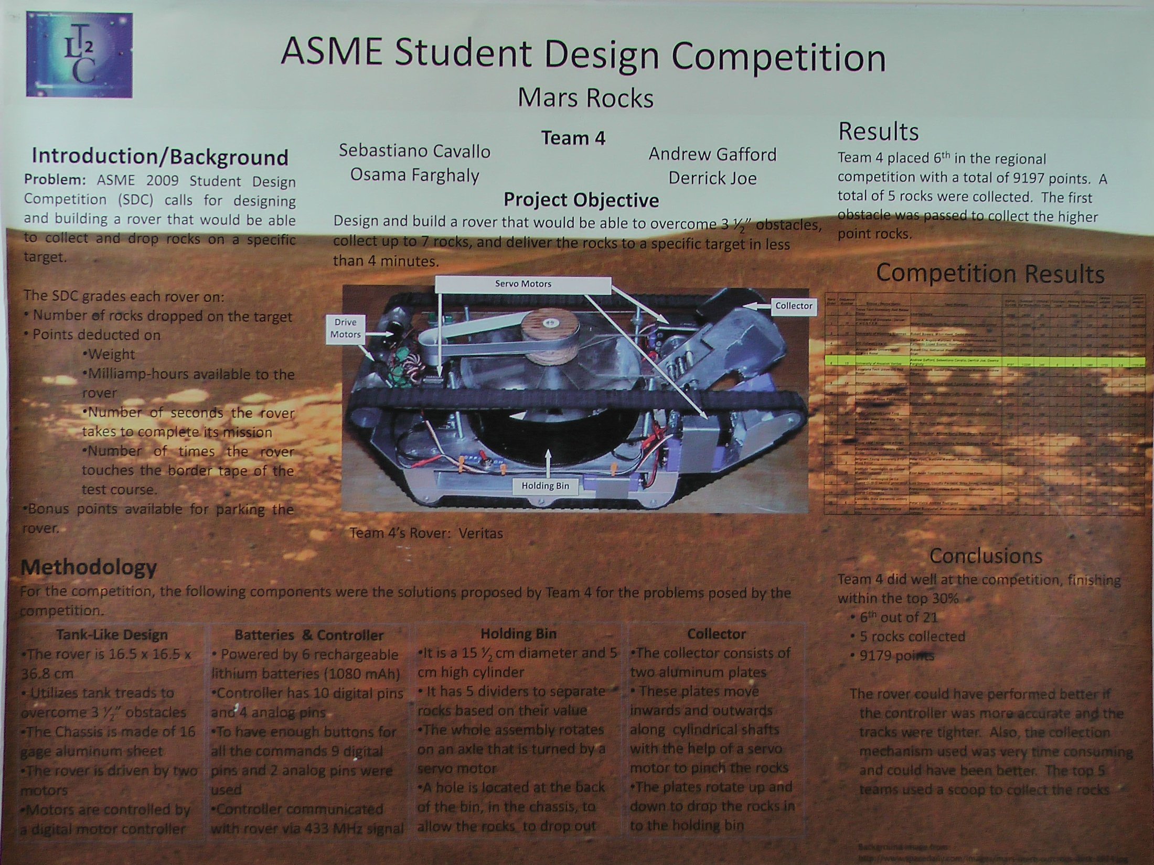

Slide 58
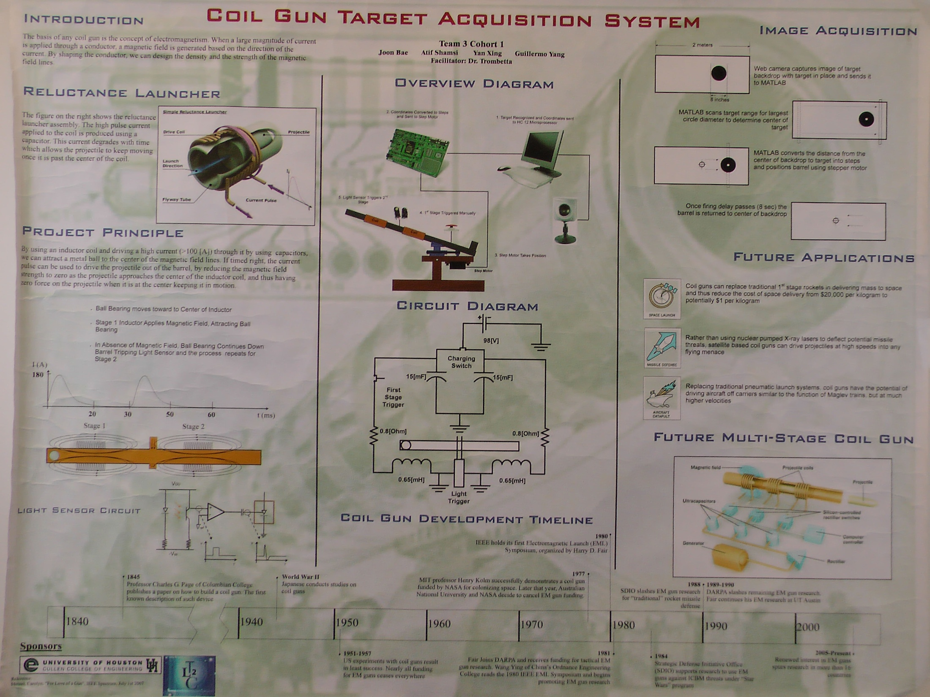

Slide 59
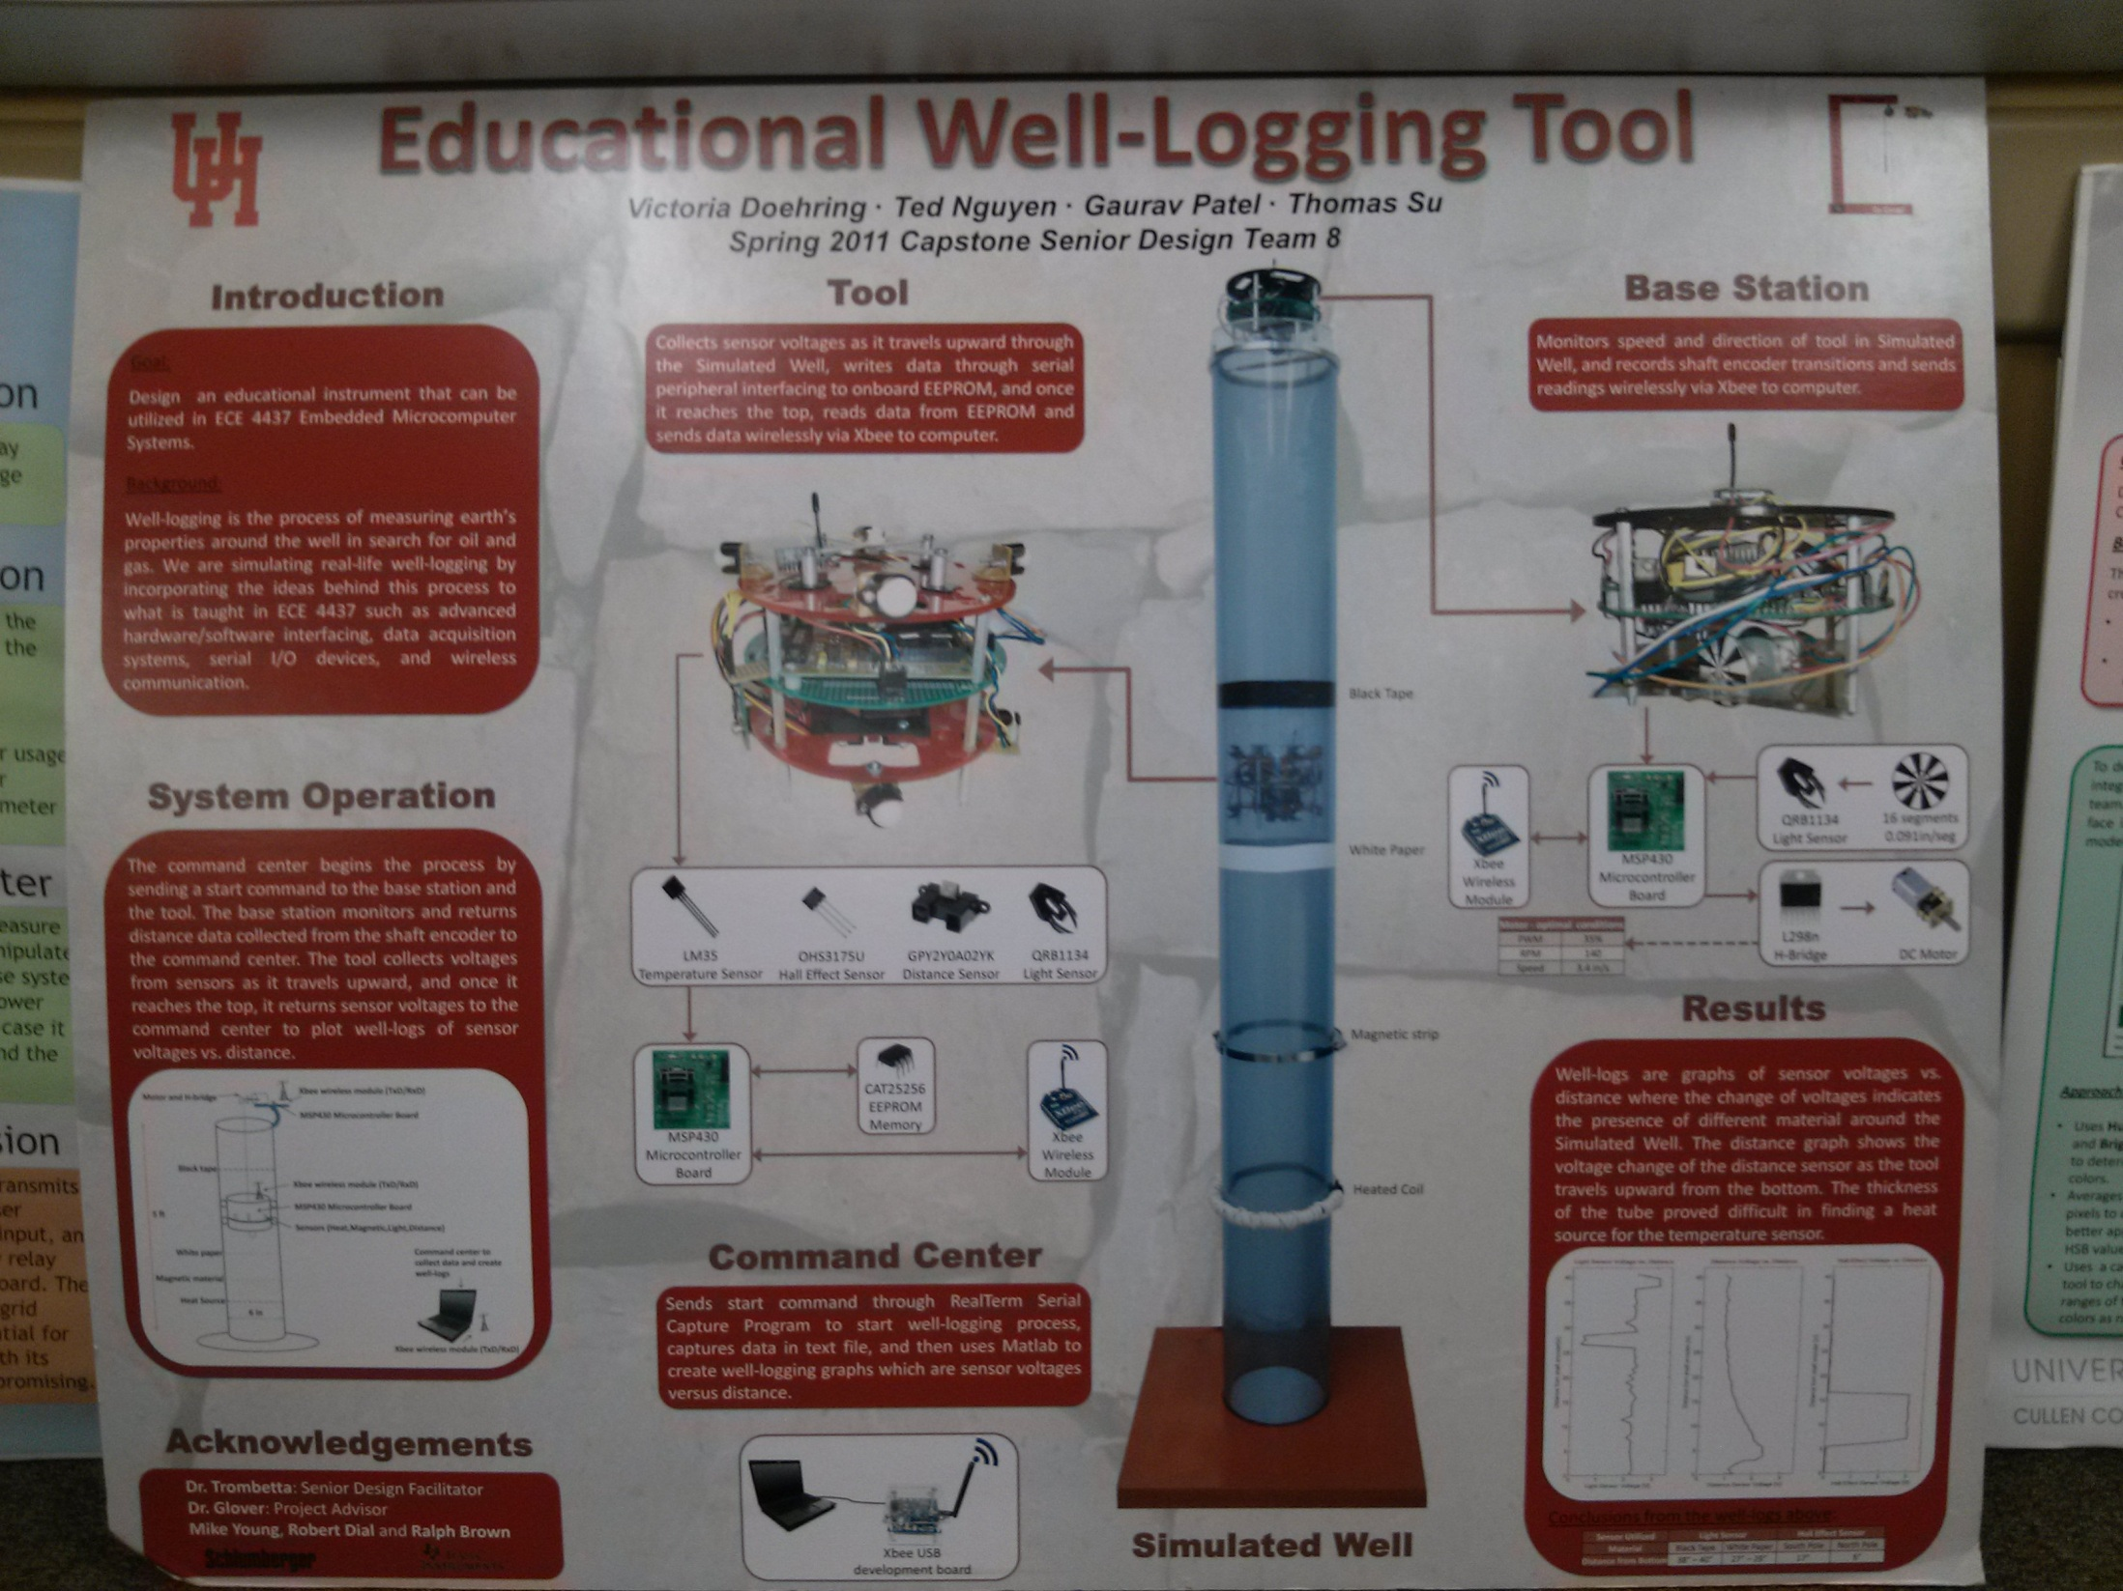

Slide 60


Slide 61


Slide 62


Slide 63


Slide 64


Slide 65


Slide 66
PROMES
Logo Here
Descriptive title of project
Team
Logo Here
Titles for projects like this one are usually a description of the thing you designed:
“A method for determining X”
“A health-monitoring wristwatch using X (the method for monitoring health)”
“A safety system allowing both vehicles and pedestrians ”
“A computer security system designed using the X method”
Name
More names
Affiliations
Problem/need/significance
Get the reader interested in why this project is necessary. This section could be broken down into three separate sections or it could be combined.
Explain what the reader needs to know in order to understand the project.
Be sure to use lots of bullets (Wilson 2008).
May include the user analysis here.
Explain what the object in the figure is. Don’t just let tables or figures stand alone; use labels on the figures themselves.
Goal
State the main purpose of the project. Exactly what are you doing? What are you trying to prove? REMEMBER TO CHANGE THE FONT SIZES TO ~32 for a regular 3 ft by 4 ft printed poster. For this section, I recommend beginning with something like
“To create a system that can wireless transmit daily health monitoring data to a home computer.”
Results
Explain how well your deliverable works:
Should usually be in a graph or other figure.
Can give a percentage of how often it works the way it is supposed to.
Be sure to define how it is supposed to work.
Table or figure
Include a figure that helps explain the problem, need, or significance. Be sure to include labels on all figures. Could be a picture of previous designs with labels about its problems.
Overview Diagram with Labels
Should be a labeled picture of the thing you actually produced, your deliverable.
Be sure to use lots of labels. (But not so many that it is cluttered.) Do not think that we will see what you want us to see just because you show it to us.
Include a picture/drawing of your proposed design.
Include small explanations with the breakout text boxes, if necessary.
Always try to figure out a way to make your information graphical or figural.
Figure explaining the results
Table or figure
Expanded “blow-up” view of the part of the overview diagram. You should have a clear title for this diagram, too, and include labels on everything.
(Optional)
User analysis
or methodology
Who will use the device or system?
Remember to use an introductory sentence or two that lead into your bullets (Finkelstein 2009).
How will they use the device? How will impact them?
Where will they use the device (can be a part of the question above)?
What is the skill level of the user?
Use small figures even within small sections like this one.
Do not include big columns of information on a poster.
Make sections bigger or smaller as necessary.
Breakout figure that shows the major components of your design.
(Optional)
Conclusions or recommendations
Now that your project is complete, what further work is necessary to improve it or to get it working the way you want it to.
Do not just answer every question here. Use bullets and combine answers as useful or necessary.
Small figure here that helps to explain a bullet point in the user analysis or some other small part. Could even include a figure of the user with labels showing how, where, skill level, etc. All of the user analysis could be explained in a figure. May not need the text section.
Literature Cited
Use APA format for citations. Remember that if you take anything from a source (pictures, tables, information), you should ALWAYS CITE IT.

Slide 67
Logo Here
Descriptive title of educational project
Logo Here
Titles for project like this one often include a gerund at the beginning.
“Teaching high school students to...”
“Using X method to teach junior high students...”
“A new method for teaching X to junior high students.”
Name
More names
Affiliations
Explain what the object in the figure is. Don’t just let tables or figures stand alone; use labels on the figures themselves.
Introduction/background
Get the reader interested in why this project is necessary.
Explain what the reader needs to know in order to understand the project.
Be sure to use lots of bullets (Wilson 2008).
Results
Results for an educational project explain one or more of the following:
How well the module reached your intended goal.
How well the students learned the material.
Objective
State the main purpose of the project. Exactly what are you doing? What are you trying to prove? REMEMBER TO CHANGE THE FONT SIZES TO ~32 for a regular 3 ft by 5 ft printed poster. For this section, I recommend beginning with something like
“To teach a class of eigth graders the basics of X using Y method or module.”
Table or figure
Include a figure that helps explain the background of the project, why the project is necessary. Be sure to include labels on all figures.
Figure demonstrating results
Include a graph, picture, table, or some other method for figurally representing how well your project worked.
Always try to figure out a way to make your information graphical or figural.
Overview diagram with labels
Be sure to use lots of labels. Do not think that we will see what you want us to see just because you show it to us.
Show us a picture of your method or a graph of how well it worked.
Show us a picture of you teaching the class with everything labeled.
Include small explanations with the breakout text boxes, if necessary.
Table or figure
Here, you can have an expanded “blow-up” view of the part of the overview diagram. You should have a clear title for this diagram, too, and include labels on everything.
Conclusions (or Recommendations)
Go into further recommendations. For instance, you may recommend one or more of the following:
Improvements to the teaching model.
How to assess the students’ learning.
How this module can be incorporated into a larger curriculum.
How to distribute this teaching module so that other teachers may use it.
Do not just answer every question. Use bullets and combine answers as useful or necessary.
Breakout figure that explains something about your project, methodology, teaching method, or results.
Methodology
Why did you choose the teaching method that you did?
Remember to use an introductory sentence or two that lead into your bullets (Finkelstein 2009).
Explain where you got your teaching method from.
Use small figures even within small sections like this one.
Do not include big columns of information on a poster.
Make the methodology, etc. bigger or smaller as necessary.
Small figure here that helps to explain a bullet point in the methodology or some other small part.
Literature cited
Use numbering, APA, or MLA citations. Remember that if you take anything from a source (pictures, tables, information), you should ALWAYS CITE IT.

Slide 68
Logo Here
Descriptive Title of Project Here
Logo Here
Name
More names
Affiliations
Introduction/Background
Get the reader interested in why this project is necessary. Then explain what the reader needs to know in order to understand the project.
Be sure to use lots of bullets (Wilson 2008).
Bullets are easier to read then regular text.
Avoid long paragraphs and any big blocks of text. Try to state your points very succinctly.
Discussion/Implications
Discuss what the results mean. Do not simply present results and let them stand by themselves, but interpret them for us.
If there are any discrepancies, tell us why.
Even try to anticipate objections or questions and go through them here.
Objective/Hypothesis
State the main purpose of the project. Exactly what are you doing? What are you trying to prove? REMEMBER TO CHANGE THE FONT SIZE TO ~32 FOR BODY TEXT. And feel free to move things around!
Results
Results and discussion are the most important parts of the project. Use tables and figures to display them and then discuss them in the discussion/implications section. Remember that figures are often easier to read than tables.
Table or Figure
Often, there is a chart, table, or photograph that helps explain why the project is necessary. Insert that here. Remember to explain all figures, though. If there is no introductory figure, then move the methodology up and insert a methodology table or figure below.
Figure explaining discussion section
Figure explaining results
Figure explaining results
Figure 1. Remember to use table and figure captions! I
Figure 4. Some smaller figures do not need captions, like the one in the methodology section.
Methodology
Methodology can both explain the theories behind why you chose to do this particular experiment as well as explain exactly what you did.
Remember to use an introductory sentence or two that lead into bullets.
Even your bullets can have small figures with them.
You are not tied to big columns of information on
a poster.
Make the methodology, etc. bigger or smaller as necessary.
Figure 3. Some people will only look at the tables and figures, so you need to make them self explanatory. Avoid captions that say, “Results.” Instead, say, “Results show that 35% of all tests were successful. Of these 35%, only 7.4% were predicted……”
Conclusions
Go into further studies that are needed.
Recommend further work.
Go into the broader aspects.
Now that we know this about the subject, how does that knowledge affect the field, or the greater scientific community?
Figure 2. In general, all captions look better below the tables and figures in posters, so don’t worry about putting table titles above and figure titles below.
Small figure here that helps to explain a bullet point in the methodology
Literature Cited
Use numbering, APA, or MLA citations.

Slide 69
Logo Here
Descriptive Title of Design Project Here
Logo Here
Name
More names
Affiliations
Introduction/Background
Get the reader interested in why this project is necessary. Then explain what the reader needs to know in order to understand the project.
You may want to include the specification for the new design here, or include them under a separate heading.
Be sure to use lots of bullets (Wilson 2008).
Bullets are easier to read then regular text.
Avoid long paragraphs and any big blocks of text. Try to state your points very succinctly.
Results
Results here explain how we know the object/design actually meets the specifications outlined in the introduction. You should test the object/design and report on the testing. Sometimes this part is called validation.
Objective/Hypothesis
State the main purpose of the project. Exactly what are you doing? What are you trying to prove? REMEMBER TO CHANGE THE FONT SIZES TO ~32 for regular type.
Overview Diagram with Labels
Figure demonstrating results
Table or Figure
Here, you can have an expanded “blow-up” view of the part of the overview diagram. You should have a clear title for this diagram, too, and include labels on everything.
Figure 1. If you label everything on the figures, you may not need to use figure captions. If you do use them, follow the rules!
Conclusions
Go into further studies that are needed.
Recommend further work.
Go into the broader aspects.
Now that we know this about the subject, how does that knowledge affect the field, or the greater scientific community?
Explain what the object in the figure is. Don’t just let tables or figures stand alone.
Figure explaining discussion section. You should be able to include at least a couple more arrows and explanations when the fonts are changed, etc.
Methodology
Methodology can explain the theories behind why you chose this particular design. These sections are not absolutely necessary, and do NOT simply narrate what you did. We’re more interested in why you made the choices you did. These ideas can come out in the separate other sections.
Remember to use an introductory sentence or two that lead into bullets.
Even your bullets can have small figures with them.
You are not tied to big columns of information on
a poster.
Make the methodology, etc. bigger or smaller
as necessary.
Small figure here that helps to explain a bullet point in the methodology
Literature Cited
Use numbering, APA, or MLA citations.

Slide 70

Sample labeling of figures

Slide 71
Sample labeling of figures
Paperclips
D battery
Magnet
Copper wires

Slide 72

Logo Here
Descriptive title of educational project
Logo Here
Titles for project like this one often include a gerund at the beginning.
“Teaching high school students to...”
“Using X method to teach junior high students...”
“A new method for teaching X to junior high students.”
Name
More names
Affiliations
Introduction/background
Get the reader interested in why this project is necessary.
Explain what the reader needs to know in order to understand the project.
Be sure to use lots of bullets (Wilson 2008).
Results
Results for an educational project explain one or more of the following:
How well the module reached your intended goal.
How well the students learned the material.
Objective
State the main purpose of the project. Exactly what are you doing? What are you trying to prove? REMEMBER TO CHANGE THE FONT SIZES TO ~32 for a regular 3 ft by 5 ft printed poster. For this section, I recommend beginning with something like
“To teach a class of eigth graders the basics of X using Y method or module.”
Table or figure
Include a figure that helps explain the background of the project, why the project is necessary. Be sure to include labels on all figures.
Figure demonstrating results
Include a graph, picture, table, or some other method for figurally representing how well your project worked.
Paperclips
D battery
Magnet
Conclusions (or Recommendations)
Go into further recommendations. For instance, you may recommend one or more of the following:
Improvements to the teaching model.
How to assess the students’ learning.
How this module can be incorporated into a larger curriculum.
How to distribute this teaching module so that other teachers may use it.
Copper wires
Methodology
Why did you choose the teaching method that you did?
Remember to use an introductory sentence or two that lead into your bullets (Finkelstein 2009).
Explain where you got your teaching method from.
Use small figures even within small sections like this one.
Do not include big columns of information on a poster.
Make the methodology, etc. bigger or smaller as necessary.
Small figure here that helps to explain a bullet point in the methodology or some other small part.
Literature cited
Use numbering, APA, or MLA citations. Remember that if you take anything from a source (pictures, tables, information), you should ALWAYS CITE IT.

Slide 73


Sample methodology

Slide 74
Methodology

Slide 75
Methodology
The hands-on portion of the teaching module involved five parts:
Demonstrating of how a DC motor works
Showing students how to build their own version of the DC motor
Providing all students with their own bag of materials
Guiding students through creating their own DC motors
Troubleshooting problems
Demonstrating how the DC motor works
Showing students how to build and operate their own DC motor

Slide 76


Logo Here
Descriptive title of educational project
Logo Here
Titles for project like this one often include a gerund at the beginning.
“Teaching high school students to...”
“Using X method to teach junior high students...”
“A new method for teaching X to junior high students.”
Name
More names
Affiliations
Introduction/background
Get the reader interested in why this project is necessary.
Explain what the reader needs to know in order to understand the project.
Be sure to use lots of bullets (Wilson 2008).
Results
Results for an educational project explain one or more of the following:
How well the module reached your intended goal.
How well the students learned the material.
Objective
State the main purpose of the project. Exactly what are you doing? What are you trying to prove? REMEMBER TO CHANGE THE FONT SIZES TO ~32 for a regular 3 ft by 5 ft printed poster. For this section, I recommend beginning with something like
“To teach a class of eigth graders the basics of X using Y method or module.”
Table or figure
Include a figure that helps explain the background of the project, why the project is necessary. Be sure to include labels on all figures.
Figure demonstrating results
Include a graph, picture, table, or some other method for figurally representing how well your project worked.
Paperclips
D battery
Methodology
Magnet
Conclusions (or Recommendations)
Go into further recommendations. For instance, you may recommend one or more of the following:
Improvements to the teaching model.
How to assess the students’ learning.
How this module can be incorporated into a larger curriculum.
How to distribute this teaching module so that other teachers may use it.
Demonstrating how the DC motor works
The hands-on portion of the teaching module involved five parts:
Demonstrating of how a DC motor works
Showing students how to build their own version of the DC motor
Providing all students with their own bag of materials
Guiding students through creating their own DC motors
Troubleshooting problems
Copper wires
Literature cited
Use numbering, APA, or MLA citations. Remember that if you take anything from a source (pictures, tables, information), you should ALWAYS CITE IT.
Showing students how to build and operate their own DC motor

Slide 77

Questions?

Slide 78
Titles

Slide 79
Quadrature encoder for drilling rig draw works

Slide 80
Live from the OR…It’s Operation C-Section!

Slide 81
Reflected light curves of extrasolar planets

Slide 82
Assessment of reading habits among engineering students and strategies for enhancing reading skills

Slide 83
Designing a low-cost pollution prevention plan to pay off at the University of Houston
Using facial symmetry to handle pose variation in real-world 3D face recognition
Yurika Diaz Bialowas, Emmett C. Sullivan, and Robert D. Schneller
Georgios Passalis, et al.

Slide 84
Distribution and persistence of Escherichia coli and Enterococci in stream bed and bank sediments from two urban streams in Houston, TX
Robin Brinkmeyer, et al.

Slide 85


